Slide 1
Lecture 15
Materials Science and Engineering
International University
National University – HCMC
Dr. Nguyen Dinh Uyen

Slide 2
Chapter 20
Magnetic Properties
Dr. Uyen Nguyen

Slide 3
Chapter 20
ISSUES TO ADDRESS...
How do we measure magnetic properties?
What are the atomic reasons for magnetism?
Materials design for magnetic storage.
How are magnetic material classified?

Slide 4
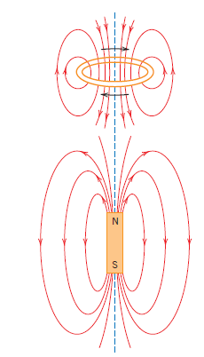
Magnetic field (H) exists at
1. Loop of current
2. Around a magnet

Slide 5
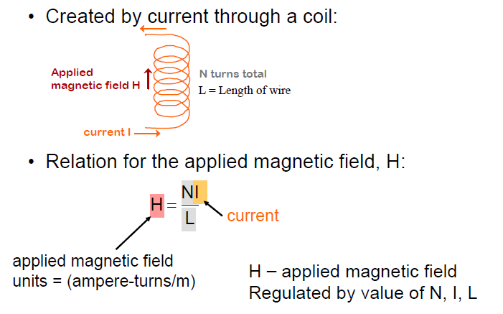

Slide 6
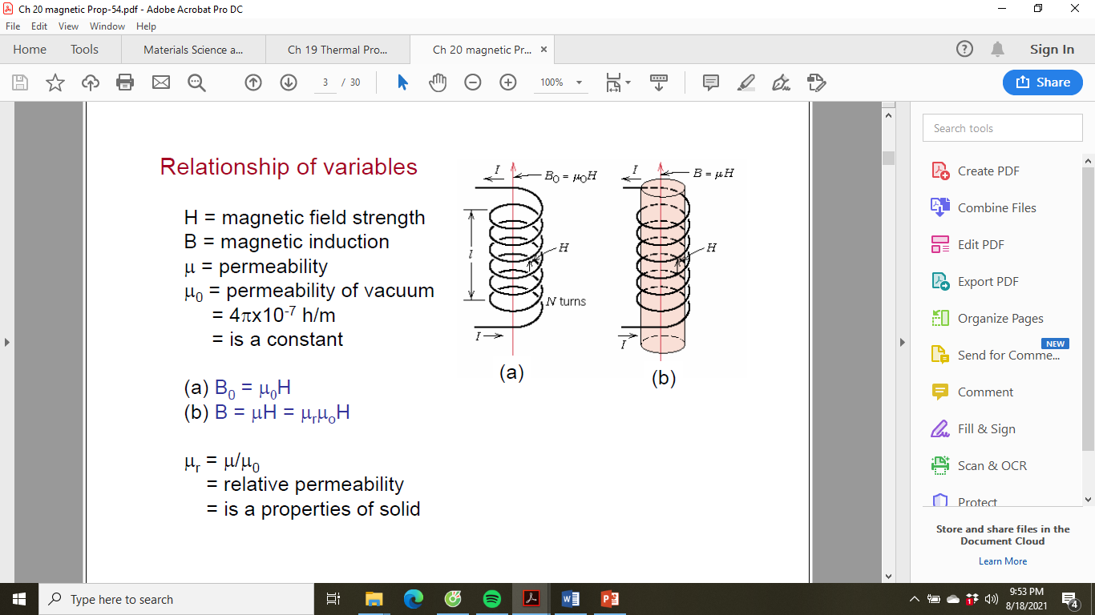
Air, or vacuum
Material

Slide 7
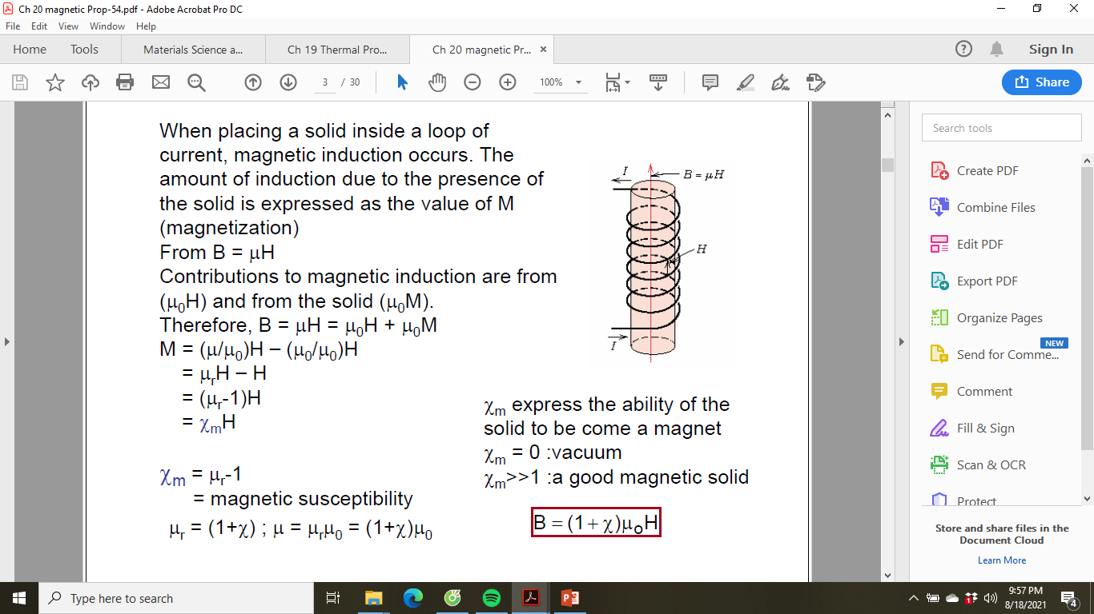

Slide 8
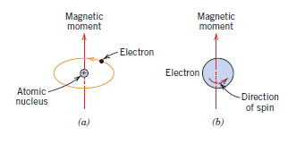


Slide 9
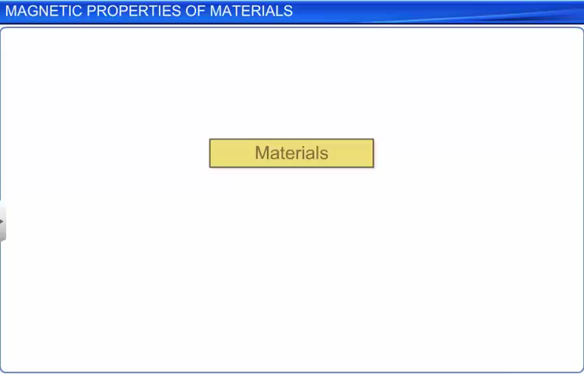

Slide 10
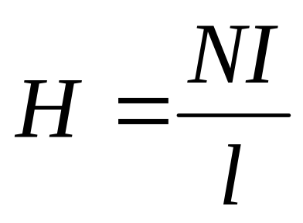
t
A coil of wire 0.20 m long and having N turns carries a current of 10 A.
Use matlab to calculate the magnitude of the magnetic field strength H?
For N from 100 to 300 turns. Plot the H field versus the N turns.
l là độ dầy của dây, kh phải độ dài

Slide 11
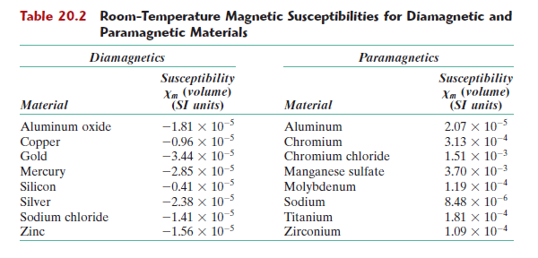
Write a Matlab code to compute the flux density (M) inside a bar of titanium that is positioned within the coil of wire 0.20 m long and having 200 turns carries a current of 10 A

Slide 12
HW
Reading: Chapter 9: Phase Diagrams
Read chapter 20
HW
20.1
20.5
20.6
Core Problems: HW: Ch7 # 6,9,11, CH8 #16, 29
Self-help Problems:

